Slide 1

CAR MARKET TRENDS
CarDekho Data Analysis
AICTE ID: - STU6a66457af37dd1785087354
Rajesh Roy
Notes:
Opening: introduce the dataset and the goal of explaining used-vehicle price patterns.
[Sources]
- 1776311302-P3-Car Market Trends Analysis with Car Dekho Data.csv (user-provided dataset; 301 rows)
[/Sources]

Slide 2

PROBLEM STATEMENT
Used-vehicle prices vary widely across models and histories. This analysis asks:
• Which attributes are linked to higher selling prices?
• How do fuel and transmission segments compare?
• How quickly does value retention fall with age?
Notes:
Frame the work as descriptive market analysis rather than a causal pricing model.
[Sources]
- 1776311302-P3-Car Market Trends Analysis with Car Dekho Data.csv (user-provided dataset; 301 rows)
[/Sources]

Slide 3

PROJECT APPROACH
DATASET
• 301 listings across 98 named models
• Model years 2003–2018; no missing values
• Nine fields covering price, kilometres, fuel, seller, transmission and ownership
METHOD
• Validate data types and completeness
• Build descriptive statistics and grouped comparisons
• Calculate value retention and key correlations
• Translate findings into buyer and seller decisions
Notes:
Value retention is defined as selling price divided by present price.
[Sources]
- 1776311302-P3-Car Market Trends Analysis with Car Dekho Data.csv (user-provided dataset; 301 rows)
[/Sources]

Slide 4
WHO USES THESE INSIGHTS?
• BUYERS - benchmark asking prices and evaluate depreciation risk
• DEALERS - compare inventory segments and prioritize valuable stock
• SELLERS - set realistic expectations using age and usage signals
• ANALYSTS & STUDENTS - examine how vehicle attributes relate to value
Notes:
Explain how the same descriptive findings support different market decisions.
[Sources]
- 1776311302-P3-Car Market Trends Analysis with Car Dekho Data.csv (user-provided dataset; 301 rows)
[/Sources]

Slide 5

TOOLS & METHODS
DATA & PREPARATION
• Python + pandas: load, validate and create features
• Retention = selling price ÷ present price
ANALYSIS & OUTPUT
• Averages and medians by fuel, transmission, seller and owner
• Correlations across price, year and kilometres
• Editable PowerPoint charts with sample-size notes
Notes:
The analysis uses descriptive statistics; no predictive-model accuracy is claimed.
[Sources]
- 1776311302-P3-Car Market Trends Analysis with Car Dekho Data.csv (user-provided dataset; 301 rows)
[/Sources]

Slide 6
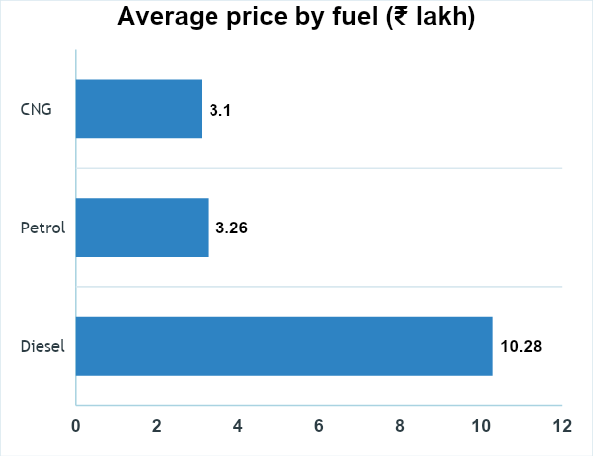
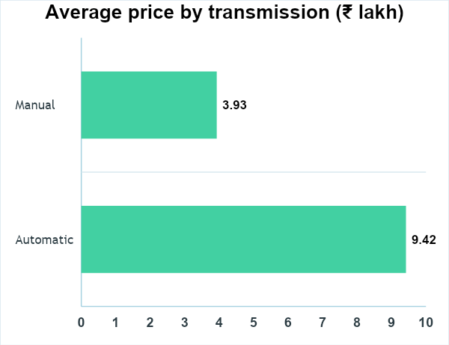
PRICE MIX
₹4.66 lakh
average selling price
₹3.60 lakh
median selling price
Diesel and automatic listings show higher average prices.
COLAB
GITHUB
Notes:
Means are descriptive and affected by the models represented in each segment. Fuel sample sizes: Diesel 60, Petrol 239, CNG 2. Transmission sample sizes: Automatic 40, Manual 261.
[Sources]
- 1776311302-P3-Car Market Trends Analysis with Car Dekho Data.csv (user-provided dataset; 301 rows)
[/Sources]

Slide 7
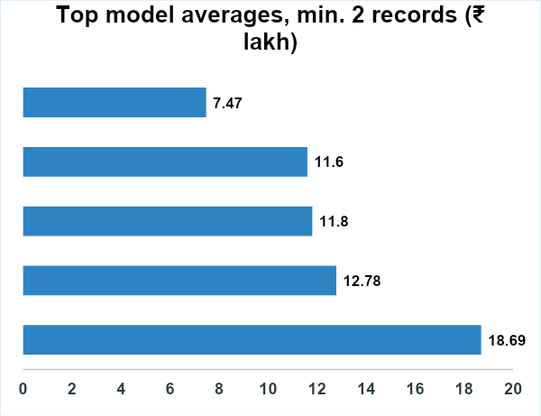
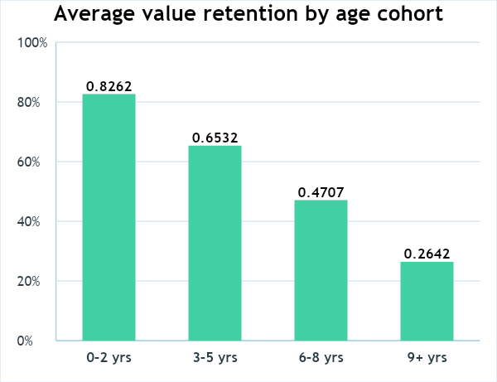
AGE & VALUE
65.5%
median value retention
0.879
present-price correlation
Retention drops from 82.6% (0–2 yrs) to 26.4% (9+ yrs).
COLAB
GITHUB
Notes:
Age cohorts are calculated relative to the dataset's latest model year (2018). Cohort sizes: 0–2 years 86, 3–5 years 132, 6–8 years 57, 9+ years 26. Top model averages require at least two records.
[Sources]
- 1776311302-P3-Car Market Trends Analysis with Car Dekho Data.csv (user-provided dataset; 301 rows)
[/Sources]

Slide 8
KEY TAKEAWAYS
Three decisions stand out from the analysis
BENCHMARK
PRIORITIZE AGE
PRICE WITH CONTEXT
Use the ₹3.60 lakh median as a steadier centre than the ₹4.66 lakh mean.
0–2 year vehicles retain 82.6% of present value on average.
Fuel, transmission and model mix change averages - compare like with like.
Notes:
Close by emphasizing robust benchmarks, age-related depreciation and the need for like-for-like comparisons.
[Sources]
- 1776311302-P3-Car Market Trends Analysis with Car Dekho Data.csv (user-provided dataset; 301 rows)
[/Sources]

